Slide 1
ESI Troubleshooting
INTRODUCTION
Document Title: Core for FSI Document #: 25TRGEXT000054
Rev: 5 Effective Date: 07/25/2012 Owner: Catalyst
Cerner Corporation Confidential Information
Cerner Corporation. All rights reserved. This document contains confidential information which may not be
reproduced or transmitted without the express written consent of Cerner.

Slide 2
ESI Troubleshooting Checklist
Use SCP or CEM500to determine if Inbound Comservers and CPM ESI processes are in a running state.
Check for success or failure on the ESI_LOG table.
Any helpful errors in msgview/System Message Viewer?
CMB_TEMP file
Other useful tools
reqloghl7.dat file
ESI_AUDIT go
SRVRTLVIEW go
Build tools used for initial configuration
This list is helpful when first learning how to troubleshoot interfaces.

Slide 3
Server Control Panel Tool
Use SCP to verify servers are running.
CPM ESI Server(s)
OEN Router
Inbound Com-Servers (OP_ * )
ESI Com-Servers (OP_*)
Check msgview for error messages if server crashes when starting up.
To access SCP:
Log into the domain using domain account (i.e. d_build)
Type scp at the at the AIX/VMS prompt.
Enter Cerner Millennium® user name, domain, and password.

Slide 4
Server Control Panel Tool (dir)
Server Control Panel (SCP) Viewer
scp> dir
Servers on node [aixccoon5] in domain [ASCBD]
id description
------------------
0 Service Manager
1 Shared Service Proxy
2 Connected Service Proxy
3 Shared Service Proxy (Batch)
32 Security Master
33 Server Control Panel
Transaction Database Master
Note: These are only some of the many servers in an actual domain.
Lists all servers that could be started in a domain.
Number listed is the server entry id.
Static number.
Used in start (activate an instance of a server), modify (change server properties), and show (view details of a server) commands.

Slide 5
Server Control Panel Tool (server)
scp> server
Servers running on node [aixccoon5] in domain [ASCBD]
id description msgs con state
--------------------------------------------------------------------
0 Shared Service Proxy 20692 87 running
11 Connected Service Proxy 0 0 running
12 Shared Service Proxy (Batch) 0 0 running
13 Security Master 29170 185 running
14 Server Control Panel 34101 12 running
15 Message Agent 0 0 running
16 Time Service 580 0 running
24 Transaction Database Master 28564 63 running
25 Authorize 52 1 running
26 CPM HTTP Proxy Server 0 0 running
27 CPM Script Private 1128 0 running
Note: These are only some of the many servers in an actual domain.
Lists all servers currently running in a domain.
Number listed is the server instance id.
Dynamically assigned number.
Used in stop (deactivate an instance of a server after it processes current message) and kill (immediately shutdown an instance of a server) commands.

Slide 6
ESI Log
This is a table, but there is also a tool that reads the table.
To use the tool type ESI_LOG go in ccl.
To use the table type Select * from esi_log go in ccl.
Look for Success vs Error
ESI_Error_Stat (success, warn, fail)
Error_Text
Find Message
MSH_sending_app (MSH-3), contributor_system_cd
MSH_ctrl_ident (MSH-10)
The event -- MSH_msg_type, MSH_msg_trig, order_ctrl
Instance Id

Slide 7
ESI Log
Check Performance
MSH_date, Start_dt_tm, end_dt_tm
Check last message date/time
Check Outcome
person_id, encntr_id, name_full_formatted, order_id

Slide 8
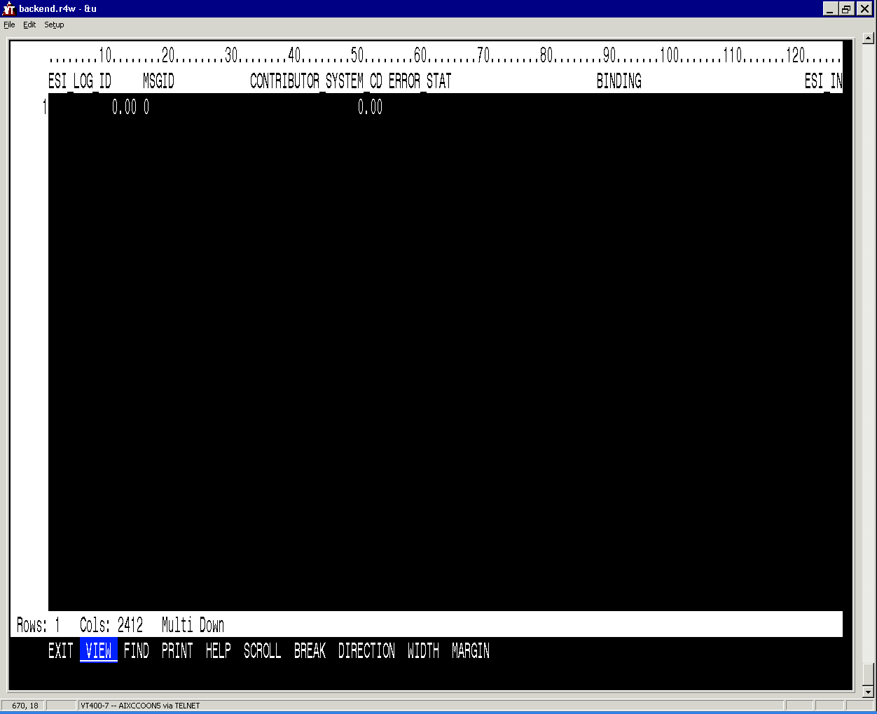
ESI Log
Select * from esi_log go

Slide 9
Msgview/System Messge Viewer
All servers, including ComServers, log messages to a .mlg file.
This file can be read using msgview from the AIX/VMS prompt or using System Message Viewer from the Cerner folder.
Troubleshoot any error or warning messages.
Question excessive audit messages.
Modify the loglevel property in SCP/CEM500.exe to hide info and debug level messages unless actively troubleshooting an issue.

Slide 10
msgview
To access msgview:
Log into the node (AIX/VMS) using a domain account (i.e. d_build).
Type msgview at the at the AIX/VMS prompt.
No log on needed.

Slide 11
msgview (dir)
msg> dir
[system]
001924 02/28 13:53 aud CallScripts callccl failed
001923 02/28 13:53 aud CallScripts %CCL-E-43-SHRCCL(0,0)S10...
001922 02/28 13:52 aud CMB_ProcessActivate1 Server process 000CA0B8 ...
001921 02/28 13:52 aud CMB_ProcessTerminate1 Server process 5296246 (...
001920 02/28 13:52 err DBAPI_Exception exception: CCL error 429...
001919 02/28 13:46 aud CRM_InvalidHandle An invalid handle was pa...
001918 02/28 13:46 aud CRM_InvalidHandle An invalid handle was pa...
001917 02/28 13:46 err Rad::ProcessCancel bad return from Img_Proc...
001916 02/28 13:46 err Rad::img_ProcesOrderCanc End: 0
001915 02/28 13:46 err Rad::LoadPersonFolder_Or valid image classtypecod...
001914 02/28 13:46 aud pft_rel_bill_hold_suspen FAILED EXECUTING PFT FIN...
001913 02/28 13:46 aud CRM_InvalidHandle An invalid handle was pa...
001912 02/28 13:46 aud CRM_InvalidHandle An invalid handle was pa...
001911 02/28 13:46 aud pft_rel_bill_hold_suspen FAILED EXECUTING PFT FIN...
001910 02/28 13:46 aud CRM_InvalidHandle An invalid handle was pa...
001909 02/28 13:46 aud CRM_InvalidHandle An invalid handle was pa...
001908 02/28 13:46 aud pft_rel_bill_hold_suspen FAILED EXECUTING PFT FIN...
001907 02/28 13:46 aud CRM_InvalidHandle An invalid handle was pa...
001906 02/28 13:46 aud CRM_InvalidHandle An invalid handle was pa...
001905 02/28 13:46 aud pft_rel_bill_hold_suspen FAILED EXECUTING PFT FIN...
dir lists messages, from newest to oldest.
Typing dir again lists the next 20 messages.
dir –new jumps up to the newest message available.

Slide 12
msgview (select)
msg> select cmb_0250
msg> dir
[cmb_0250]
000038 02/21 13:27 wrn SRV_LookupFailure {{field::data_status_cd}}
000037 02/21 13:19 wrn SRV_LookupFailure {{field::data_status_cd}}
000036 02/10 15:40 err CMB_ServiceUnavail3 Connection request to se...
000035 02/10 15:40 err CMB_ServiceUnavail3 Connection request to se...
000034 01/27 13:00 err CMB_ServiceUnavail3 Connection request to se...
000033 01/27 13:00 err CMB_ServiceUnavail3 Connection request to se...
000032 01/27 13:00 err CMB_ServiceUnavail3 Connection request to se...
000031 01/27 13:00 err CMB_ServiceUnavail3 Connection request to se...
000030 01/17 14:34 wrn PmEnsPersOrgReltn::proce Unable to retrieve free-...
000029 01/17 14:32 wrn PmEnsPersOrgReltn::proce Unable to retrieve free-...
000028 01/17 14:27 wrn PmEnsPersOrgReltn::proce Unable to retrieve free-...
000027 01/17 14:15 wrn PmEnsPersOrgReltn::proce Unable to retrieve free-...
000026 01/17 14:13 wrn PmEnsPersOrgReltn::proce Unable to retrieve free-...
000025 01/10 13:52 wrn SRV_LookupFailure {{field::data_status_cd}}
000024 01/10 13:47 wrn SRV_LookupFailure {{field::data_status_cd}}
000023 01/10 13:37 wrn SRV_LookupFailure {{field::data_status_cd}}
000022 01/10 13:24 wrn SRV_LookupFailure {{field::data_status_cd}}
000021 01/10 12:49 wrn SRV_LookupFailure {{field::data_status_cd}}
000020 01/10 09:55 wrn SRV_LookupFailure {{field::data_status_cd}}
000019 01/09 21:06 err LoginHandle::authenticat Transceive failure
The select command narrows down which server’s .mlg file is being viewed.
Number in cmb_XXXX is the server’s entry id padded with enough leading zeroes to make a 4 digit number.

Slide 13
msgview (show)
msg> show 1920
[system]
entry: 1920
date: 28 Feb 2006 13:52:39
user: [CERDBA] - [root]
location: aixccoon5/5296246/1543
source: SRV0051_01_3//1349590
sourceref: 1739394/1310000/1310000
event: DBAPI_Exception
level: error
<text>
exception: CCL error 4294967295: CCLSET_DBRESET
Show gives us the detail of an entry
Use the number in the left hand column from the dir command

Slide 14
msgview (search)
msg> search –level error
[system]
--- searching, press <ctrl-d> to terminate ---
000586 03/31 15:03 err rad_rpt_packet_reprint Invalid printer:Exampleprinter found whil...
000585 03/31 15:03 err rad_rpt_packet_reprint Invalid printer:Exampleprinter found whil...
000562 03/31 15:01 err rad_rpt_packet_reprint Invalid printer:Exampleprinter found whil...
000561 03/31 15:01 err rad_rpt_packet_reprint Invalid printer:Exampleprinter found whil...
000560 03/31 15:00 err rad_rpt_packet_reprint Invalid printer:Exampleprinter found whil...
000559 03/31 15:00 err rad_rpt_packet_reprint Invalid printer:Exampleprinter found whil...
000558 03/31 14:55 err rad_rpt_packet_reprint Invalid printer:Exampleprinter found whil...
000557 03/31 14:55 err rad_rpt_packet_reprint Invalid printer:Exampleprinter found whil...
Search allows you to do that. Search (filter) through the selected MLG file.
Can search/filter using date ranges, message level (error, warning, and so on), or specific text that is found in the data/text column.
First search command (with options), begins search. To repeat (or page down) to see more results that match options, type “search” at prompt without option.
Search has reached the end of the log file when you see --- Done --- at the end of the list.

Slide 15
CMB_TEMP Files
Log file of every step a server takes to process a message
Used when other troubleshooting tools fail to isolate the issue
Located in cmb_temp directory
SET DEF CMB_TEMP for VMS
cd $cmb_temp for AIX
File will be in the following format:
cmb_####_xx.out
#### = server’s entry ID padded with leading zeroes to equal 4 digits and
xx = which instance of the server the message processed through, padded with a leading zero to equal two digits
cmb_0250_01.out - for example

Slide 16
CMB_TEMP Files
---ESI START UP BEGIN
This new version of ESI utilizes the new SIRTL logging.
The new server properties are:
debuglogging -> CMB file logging level
loglevel -> MSGVIEW logging level
10/02 08:41:41 dbg ESI_HASHTABLE Begin {{function::LoadCodeValueAliasTable}}
10/02 08:42:04 dbg ESI_HASHTABLE End {{function::LoadCodeValueAliasTable}}
10/02 08:42:04 dbg ESI_HASHTABLE Begin {{function::LoadCodeValueExtTable}}
10/02 08:42:19 dbg ESI_HASHTABLE End {{function::LoadCodeValueExtTable}}
10/02 08:42:19 dbg ESI_HASHTABLE Begin {{function::LoadCodeValueExtTable2}}
10/02 08:42:20 dbg ESI_HASHTABLE End {{function::LoadCodeValueExtTable2}}
10/02 08:42:20 dbg ESI_HASHTABLE Begin {{function::LoadCodeValueTable}}
10/02 08:42:34 dbg ESI_HASHTABLE End {{function::LoadCodeValueTable}}
10/02 08:42:34 dbg ESI_HASHTABLE Begin {{function::LoadCdfMeaningsAndDisplay}}
10/02 08:43:02 dbg ESI_HASHTABLE End {{function::LoadCdfMeaningsAndDisplay}}
10/02 08:43:02 dbg ESI_HASHTABLE Begin {{function::LoadContribSystemTable}}
10/02 08:43:02 dbg ESI_HASHTABLE End {{function::LoadContribSystemTable}}
10/02 08:43:02 dbg ESI_HASHTABLE Begin {{function::LoadEsiEnsParmsTable}}
10/02 08:43:03 dbg ESI_HASHTABLE End {{function::LoadEsiEnsParmsTable}}
10/02 08:43:03 dbg ESI_HASHTABLE Begin {{function::LoadEsiAliasTransTable}}
10/02 08:43:04 dbg ESI_HASHTABLE End {{function::LoadEsiAliasTransTable}}
10/02 08:43:04 dbg ESI_HASHTABLE Begin {{function::LoadCMRNPool}}
10/02 08:43:04 dbg ESI_HASHTABLE End {{function::LoadCMRNPool}}
10/02 08:43:04 dbg ESI_HASHTABLE Begin {{function::LoadOeFieldMeaning}}
Note: This is just a portion of the whole file
Look for errors or anything else that looks out of the ordinary
Will usually be requested when opening up a point
Can be viewed with any text editor

Slide 17
REQLOGHL7.DAT
Will log exactly what was sent from the ESI ComServer to the CPM ESI server
Not generally used as activating this functionality degrades system performance
This file is created if the logical cpm_global_logging is assigned to anything (AIX).
To activate in VMS:
$show log cpm_global_logging
"CPM_GLOBAL_LOGGING" = "OFF"
$ define/group cpm_global_logging on
$ show log cpm_global_logging
“CPM_GLOBAL_LOGGING” = “ON”
To activate in AIX:
$ getlog cpm_global_logging
cpm_global_logging: not defined
$ setlog -g cpm_global_logging on
$ getlog cpm_global_logging
cpm_global_logging (global) --> on

Slide 18
REQLOGHL7.DAT
Message Data
1 cerner
2 SRV_STRING[0] msg_id =
1 CONTROL_GROUP(1)
CONTROL_GROUP(0)
2 MSH(1)
MSH(0)
3 SRV_STRING[4] encoding_characters = ^~\&
3 SRV_STRING[8] sending_application = OPF FEED
3 SRV_STRING[8] sending_facility = OPF TEST
3 SRV_STRING[10] receiving_application = Millennium
3 SRV_STRING[3] receiving_facility = OCF
3 SRV_STRING[13] message_time_stamp = 1998007300900
3 SRV_STRING[8] security = security
3 message_type
4 SRV_STRING[3] messg_type = ADT
4 SRV_STRING[3] messg_trigger = A01
3 message_ctrl_id
4 SRV_STRING[7] ctrl_id1 = comb001
4 SRV_STRING[0] ctrl_id2 =
3 SRV_STRING[13] processing_id = processing id
3 SRV_STRING[3] version_id = 2.2
3 SRV_STRING[6] sequence_nbr = seqNbr
Note: This is just a portion of the entire file.
Look to see that all fields have been filled out correctly.
Usually used in conjunction with a CMB_TEMP file.
Can be viewed with any text editor.

Slide 19
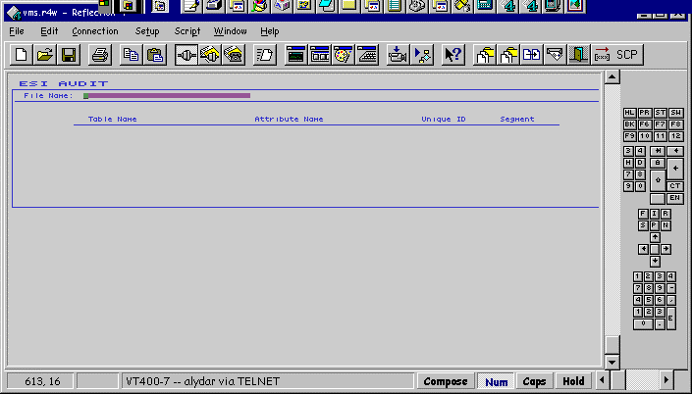
ESI_AUDIT
Used to verify information posted to the database correctly.
In CCL, enter ESI_AUDIT GO.

Slide 20
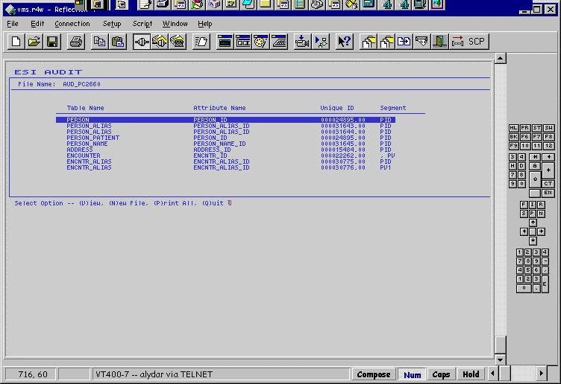
ESI_AUDIT
Select / type the filename AUD_<CONTROL_ID>.DAT (the CONTROL_ID is taken from the MSH:10).
List of table_ids updated with this transaction. Select (V)iew to see attribute values of each table.

Slide 21
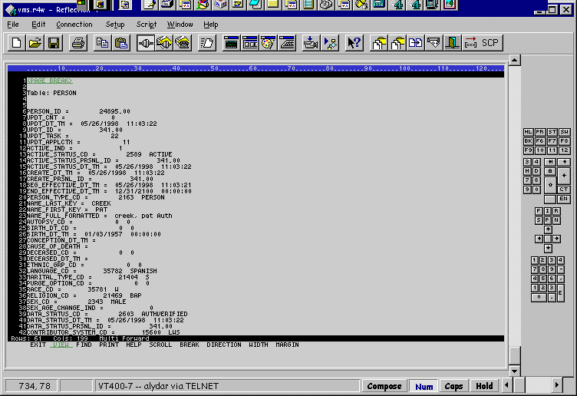
ESI_AUDIT

Slide 22
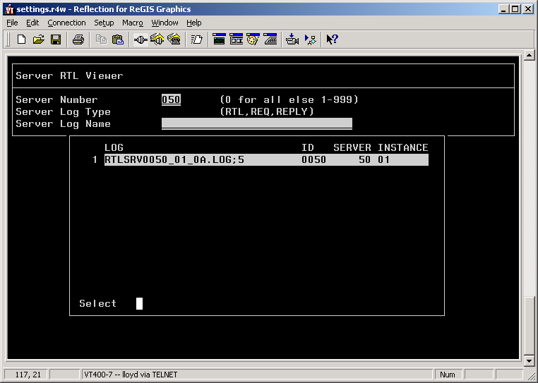
srvrtlview
RTL files log CCL errors that occur when a server attempts to run a script
srvrtlview go in CCL
Select file name, press ENTER, and look for lines with %CCL% in them

Slide 23
Additional Resources
Troubleshoot ESI Reference Page
ESI Troubleshooting Tools Reference Page

